Slide 1


Slide 2



Job analysis is the process of studying and collecting information relating to the operations and responsibilities of a specific job.
-K.Aswathappa
Right Person for the Right Job at the Right Time and In a Right Place.

Slide 3



Slide 4


Before discussing job analysis in more detail, many related terms used in personnel should be carefully defined:
TASK: A distinct work activity which has an identifiable beginning and end.
Ex: post man sorting bag full of mails in appropriate boxes
DUTY: Several tasks which are related by some sequence of events.

Slide 5

Collecting and recording job information.
Checking the job information for accuracy.
Writing job description based on information.
Using the information to determine the skills, abilities, and knowledge that are required on the job.
Updating the information from time to time.

Slide 6

There are two components in job analysis.
Job description
Job specification

Slide 7

Job Description
A written summary of tasks, duties and responsibilities of a job.
Job Specification
The minimum skills, education, and experience necessary for an individual to perform a job.

Slide 8

Job Analysis
Job Description Job Specification
Job Title
Working Hours
Duties &
Responsibilities
Working Conditions
Salaries & Incentives
Qualifications
Qualities
Experience
Family Background
Training

Slide 9
Identify a job to
analyze
Update the task list based on individual task analyses findings
Survey is administer ed to job incumbent s and supervisors of job incumbent s
Develop the target audience description
Distribute the approved critical task list
Compile the total task inventory
Obtain critical individual task list approval
Collect task performance data
Survey data is complied in a report and provided to the critical task selection board
Identify critical individual shred tasks
Nominate critical individual tasks

Slide 10
Job identification
Significant characteristics of a job
What the typical worker does?
Job duties
What materials and equipments the worker uses
How a job is performed
Required personal attributes
Job relationships

Slide 11
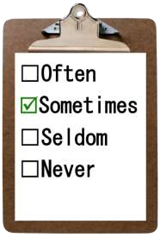

Observation
Interview
Questionnaire
Checklist
Technical conference
Diary methods

Slide 12

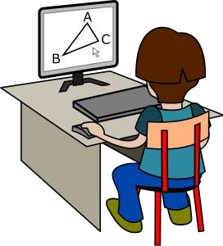
HR planning
Recruitment and selection
Orientation
Job evaluation
Training and development
Performance Appraisal
Compensation and Benefits
Career planning and development
Health and safety

Slide 13
Present immediate information
Assist in designing the requirements to perform a job.
Assist in the hiring process
Helps in performing evaluation and appraisal processes.
Assists in delivering appropriate training.
Assists in Deciding Compensation Package for a Specific Job

Slide 14
Subjective matters
Lengthy projects
Require lots of human efforts
Source of Data is Extremely Small
Unqualified Job Analyst
Mental Abilities Cannot be Directly Observed

Slide 15


Support from top management
Single means and source
No training or motivation
Activities may be distorted

Slide 16
Job Design: Definition
Job Design is the process of deciding on the content of a job in terms of its duties and responsibilities; on the methods to be used in carrying out the job, in terms of techniques, systems and procedures and on the relationships that should exist between the job holder and the superiors, subordinates and colleagues.

Slide 17

Job Rotation:
Refers to the
movement of an employee from one Job to
another.
Note That jobs themselves are not actually Changed, only employees are Rotated among various jobs.
Job Enlargement :
When a job is enlarged the tasks being performed are either enlarged or several short tasks are given to on worker, thus the scope of the Job is increased because there are many tasks to be performed by the same worker.
Job Enrichment:
Job enrichment as is currently practiced all over the work is a direct outgrowth of Herzberg’s Two factor theory of motivation.

